Slide 1

Let’s Blynk!
A PRESENTATION BY AKASH KUMAR

Slide 2

IoT is awesome, but where do we actually implement it?
Alexa! Tell me the answer! (Smart Home)
As many of you might have guessed, IoT is the basis of smart homes, like controlling lights of your house using your phone, temperature of your AC while you are still in your car, monitoring your dog while you are at work, IoT is present in all these scenarios!
Wireless control of things is very useful in many scenarios, like let’s a railway operator sees someone stuck on the tracks, he can then turn the signal lights red present near by, or even pretty far from him to stop any incoming train and prevent an accident.

Slide 3
List of uses goes on….
It can be used for medical purposes, like remotely tracking locations of medical equipments, tracking health of patients using fitness bands which can also be used by insurance company to verify the data, etc.
Can also be used for military purposes like monitoring soldiers’ location and their mental and physical health state, identifying enemies using sensors, remote access to weapons systems and other devices….
The list of application of IoT NEVER STOPS!

Slide 4
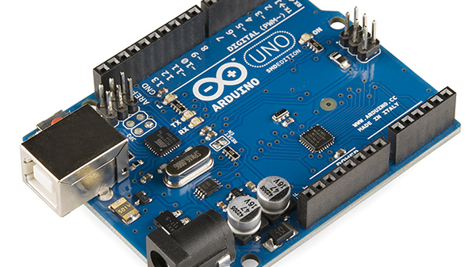
Arduino Code
This is better explained on the IDE.

Slide 5


What is Blynk?
Blynk is an application designed to control hardware remotely, display and store data, basically, it is designed for the Internet of Things!
There are 3 major components of Blynk
1) Blynk App – This allows you to create the interface to control your project using the widgets
2) Blynk Server – This is what makes the communication between the app and the hardware possible, like when you perform an action on the app, the message travels to the Blynk Cloud and finds your way to the hardware
3) Blynk Libraries – This enables the hardware to communicate with the server and processes all the incoming and outgoing messages.
Library Zip Download Link -
https://github.com/blynkkk/blynk-library/releases/tag/v0.6.1

Slide 6
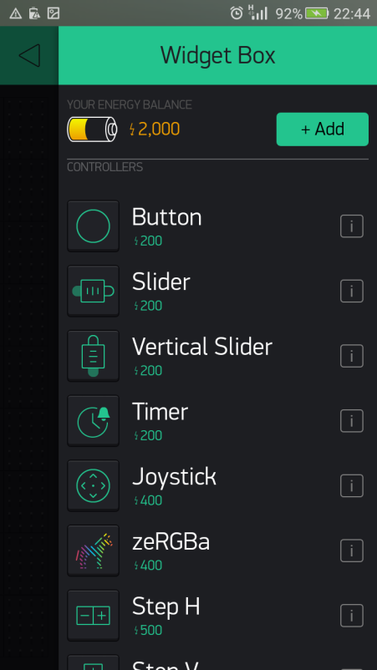
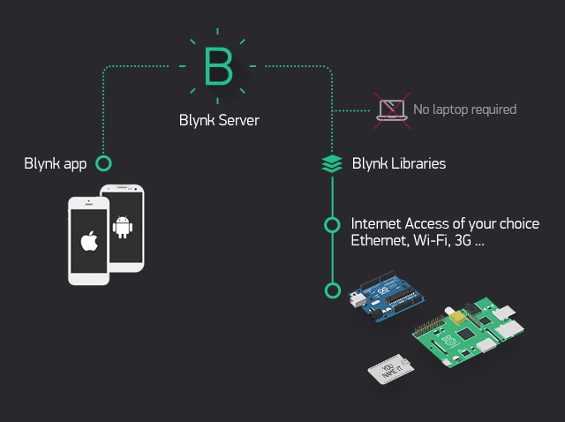

Slide 7

Let’s Blink using Blynk!
So, today we are going to blink 3 LEDs...
Using your phone! And even you guys would be able to blink it!
Let’s get started!

Slide 8

How does it work?
Basically, we send signals to the LEDs when our button is pressed.
We will be connection our LEDs to port number 13,12 and 11 on the Arduino, and when we press the button, it will create a potential difference between LED’s connected point and the grounded point, which makes the LED glow!
When we press the button, the potential of the connected port on Arduino becomes “high” or you can say “1”. When we turn off the switch, the potential of the port becomes “low” or you can say “0”.

